Slide 1
Real-Time Fraud Detection to Detect and Curtail data
Problem Statement By: Bureau
Presented By: Team CoDivas
(Nirmayi Kelkar, Pragati Sharma, Sristy Sharma, Sudiksha Agrawal)

Slide 2


To detect
Anomaly detection are important for detecting fraudulent credit card activities, fault detection in critical machinery,
anomalies) to name just a few.
Introduction

Slide 3


What is the Ideal ML Algorithm?
Unsupervised algorithm
Very good at catching anomalies in many diverse situations.
Computationally very fast
Scalable and can handle large datasets.

Slide 4
Problem Statement
Develop an API that uses machine learning to analyze payment transactions and identify suspicious activity in real-time.

Slide 5
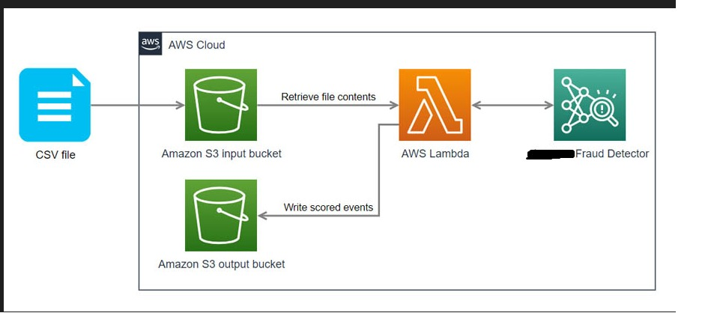
System Architecture

Slide 6
What is the Ideal ML Algorithm?
Unsupervised algorithm
2.Very good at catching anomalies in many diverse situations.
3. Computationally very fast
4. Scalable and can handle large datasets.

Slide 7

Why Isolation Forest?
Most of anomaly detection approaches such as Kmeans
construct a profile of normal instances, then identify anomalies as those that do not conform to the normal profile. This leads to two major drawbacks. The
approaches are seldom optimized and constrained to low dimensional data and small data size.
In contrast, the Isolation Forest algorithm says that anomalies: (
i) They are the minority consisting of only a few instances (ii) They have
attribute values very different from normal attribute values. Focusing on these
properties makes it easier to isolate them

Slide 8


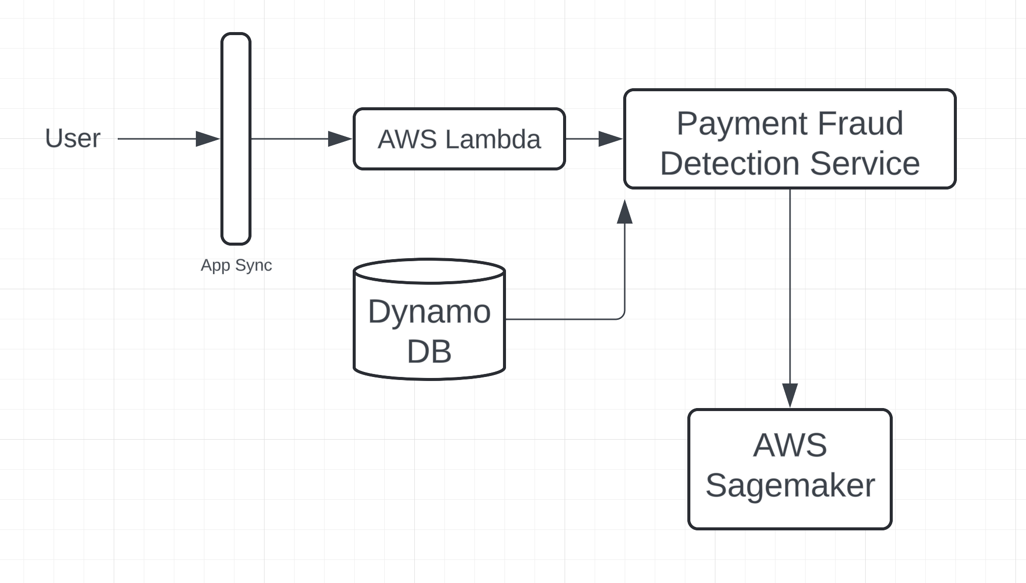



Tech Stack
Assumptions
Generated training and test data

Slide 9
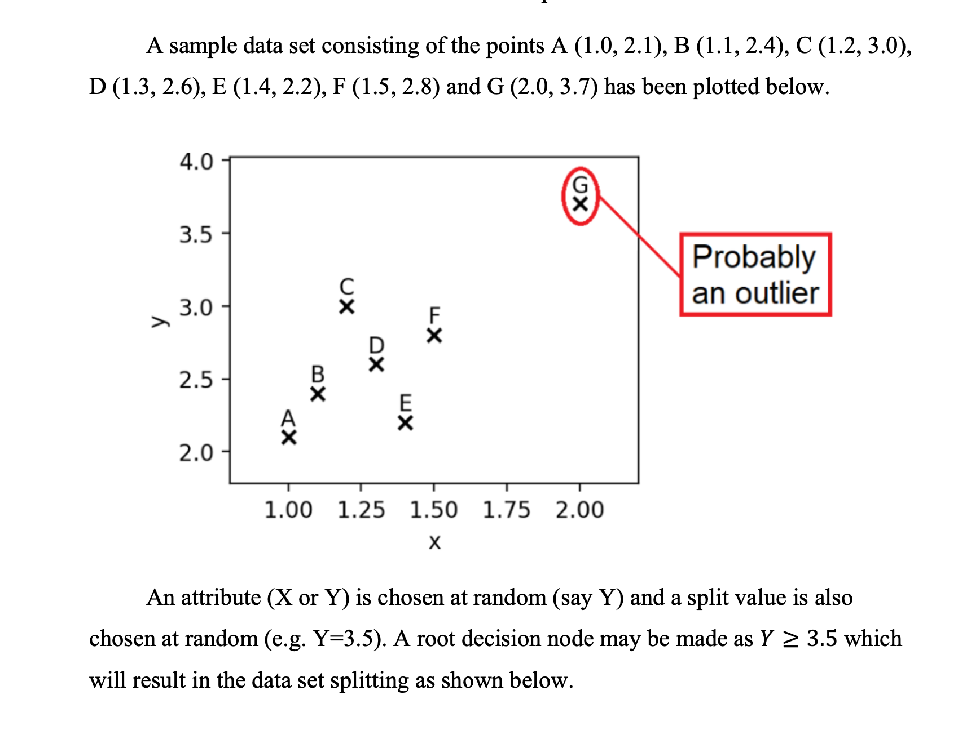
Working of isolation forest

Slide 10
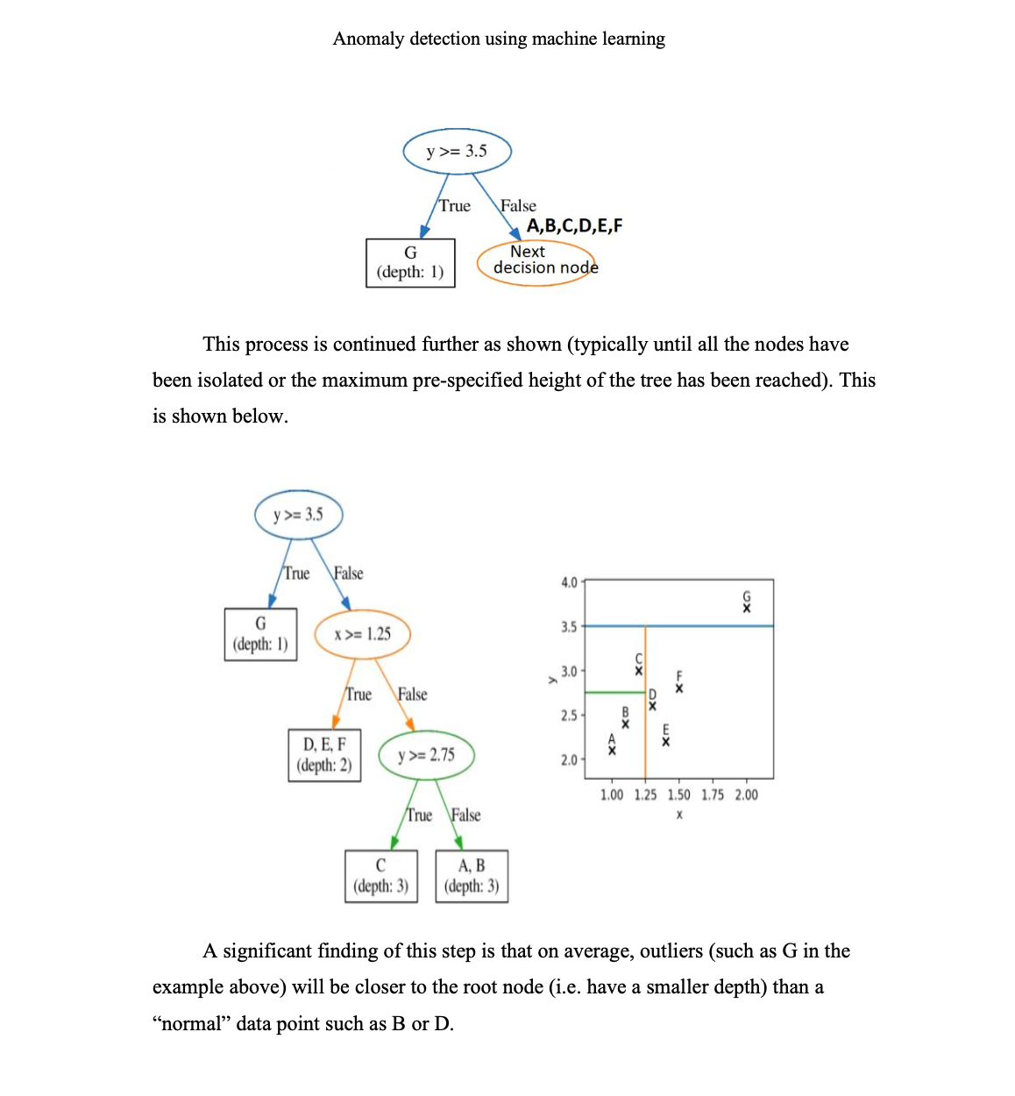

Slide 11
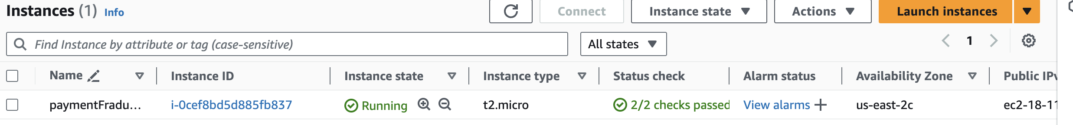
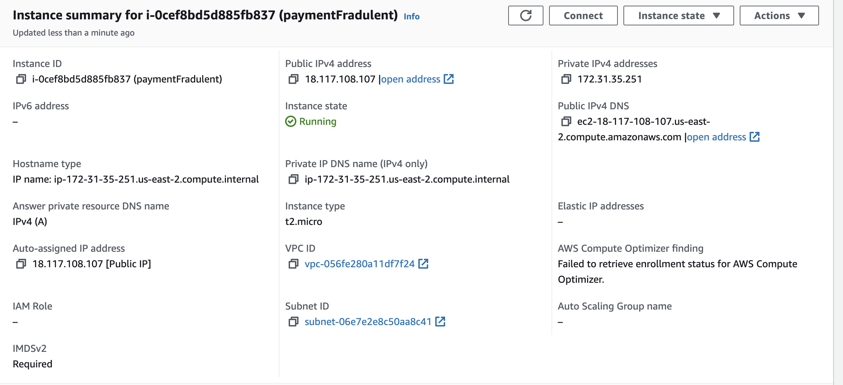
Connection to AWS Instance

Slide 12

Conditions on which we flagged the anomalies
We have handled all the 4 anomalies mentioned below:
If the user tries to make transactions with a total cumulative amount >= to 70% of the card balance and the balance >= Rs 3,00,000 within 12 hours. (RULE-001)
Users transact from more than 5 locations (the minimum difference is 200KM between two locations) and transact with that card for more than 1,00,000 Rs within a 12-hour window. (RULE-002)
If the transactions from a card don’t follow the coherent pattern of the last 12-hour/1-day/7-day window. (RULE-003)
If the transaction doesn’t follow a coherent pattern with the merchant category code of the last 3-day/7-day/30-day for the card (RULE-004)

Slide 13
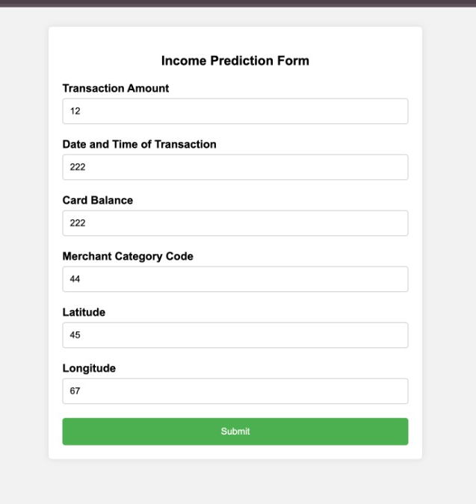

Slide 14
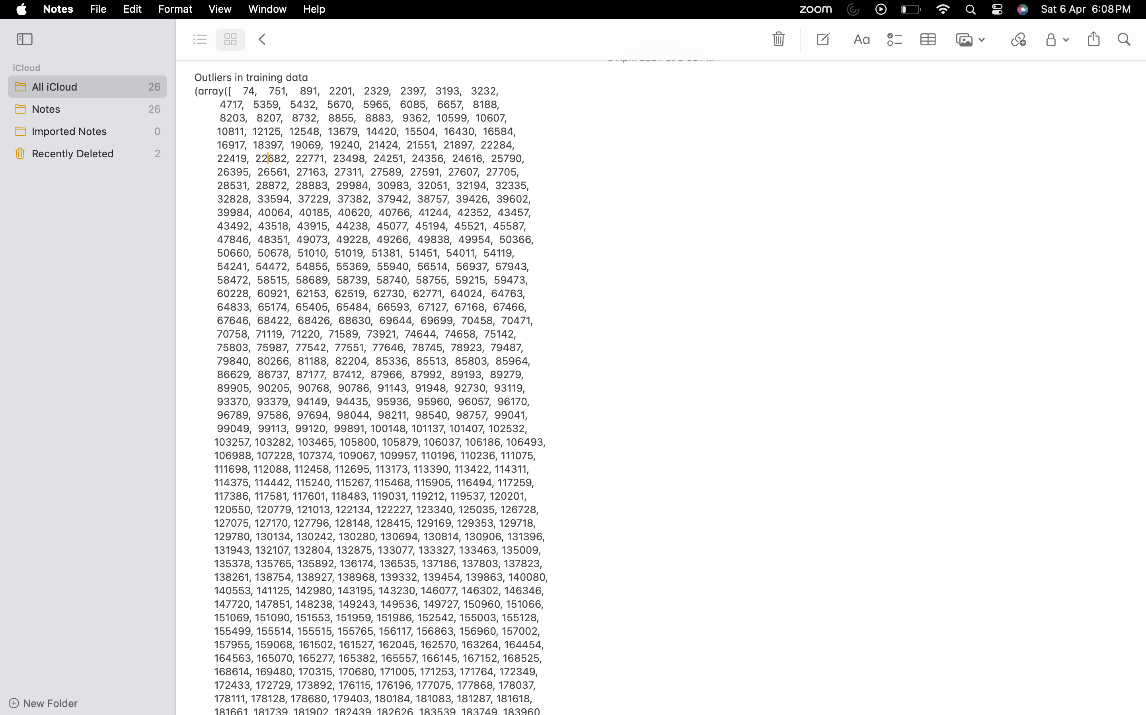
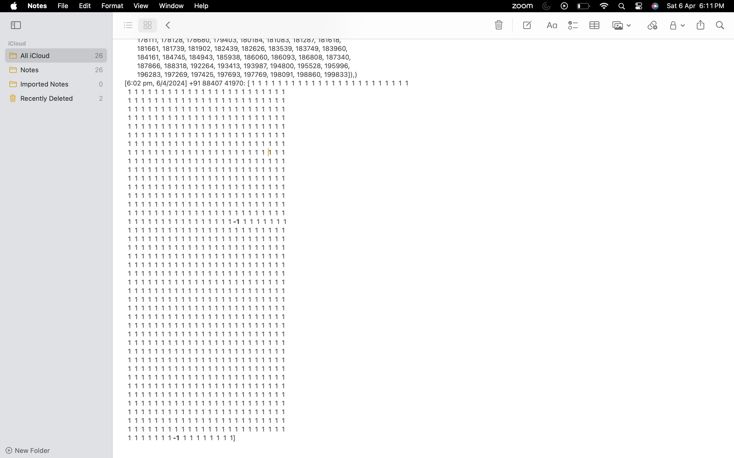
Output
-1
-1

Slide 15
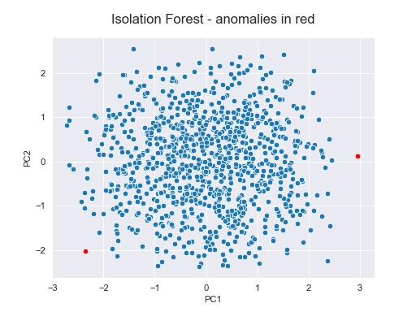
Image Capture
For 20000 training data and for 100 test data
Anomalies are shown in red.

Slide 16
Thank you!

